Slide 1
The Sensory Evaluation of Food
Chapter 6

Slide 2
The Sensory Evaluation of Food
Objectives
Vocabulary
Explain how various influences affect food choices.
Describe sensory characteristics that affect food preferences.
Plan a setting for successful sensory evaluation.
Explain the role of sensory evaluation in the food industry.
Explain the relationship between sensory characteristics and nutrition.
Flavor
Garnish
Monosodium glutamate
Mouthfeel
Olfactory
Sensory characteristics
Sensory evaluation
Sensory evaluation
Sensory evaluation panels
Taste blind
Taste buds
volatile

Slide 3
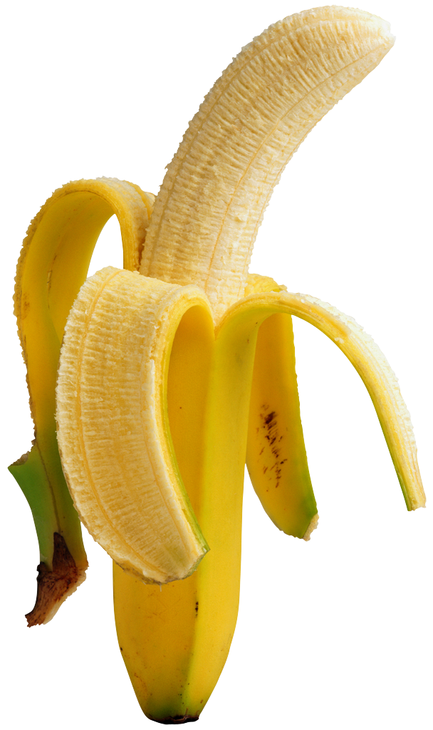
What Influences Food Choices?
Culture and Geography
Emotions and Psychology
Beliefs
Health Concerns
Food Costs
Technology

Slide 4
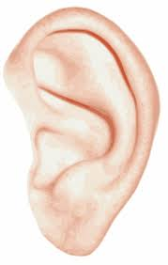
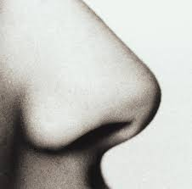
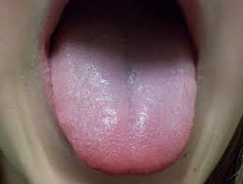
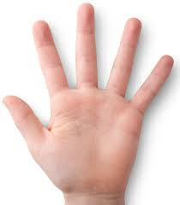
Sensory Evaluation: A Scientific Approach
Sensory evaluation – scientifically testing food, using the human senses of sight, smell, taste, touch and hearing.
Sensory characteristics – the qualities of a food indentified by the senses. How it looks, tastes, smells, sounds and feels when eaten.

Slide 5
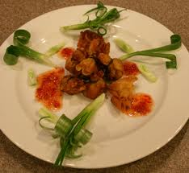
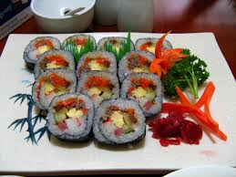
Flavor and Appearance
Flavor – distinctive quality that comes from a food’s unique blend of appearance, taste, odor, feel, and sound.
Appearance-Based on habit and preconceived notions
Garnish- a decorative arrangement added to food or drink

Slide 6
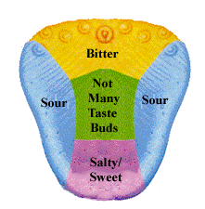
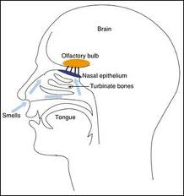
Taste and Odor
Taste blind- unable to distinguish between the flavors of some foods. (if you have a cold, you can’t taste your food)
Taste buds – sensory organs located on various parts of the tongue
Monosodium glutamate – a salt that interacts with other ingredients to enhance salty and sour tastes.
Olfactory – related to the sense of smell
Volatile – substances that are easily changed into vapor when heated and add to the odor.

Slide 7
Comparison Chart
Bitter
Sour
Coffee, bitter melon, unsweetened cocoa, citrus peels.
Bitterness of substances is compared with bitter taste threshold of quinine which is 1.
Unpleasant and disagreeable taste.
Bitter flavors are recognized by taste buds at the back of tongue, throat and palate.
Lemon, orange, grape, melon, wine and sour milk.
Sourness taste threshold is rated with respect to dilute hydrochloric acid which has a value of 1.
Sharp taste that indicates acidity of substance.
Taste buds at the sides of tongue recognize sour taste.

Slide 8
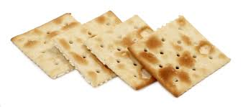
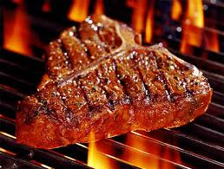
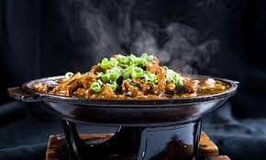
Texture
Texture – soft, brittle, grainy, chewy, hard, tender, dry, etc…
Mouthfeel – how a food feels in the mouth
Sound – crunchy foods need to sound crunchy, crackers you don’t want to be soggy.

Slide 9
Sensory Evaluation
Sensory evaluation panels – groups of people who evaluate food samples
Three main groups
Highly trained experts
Laboratory panels
Consumer panels

Slide 10
Uniform Evaluations
Minimize distractions – testing takes place in a controlled atmosphere. Light and temperature are kept constant.
Minimize bias – researchers may mask irrelevant characteristics.
Objective Evaluations – offer a greater degree of control and consistency.

Slide 11
Experiment 6
Odor Recognition

